Slide 1
Integrating Dynatrace through APIs

Slide 2
Timeseries Problems Events Topology Real User Sessions Logs
Third Party Events Comments Tags Configuration
ActiveGate Plugins
Custom Plugins

Slide 3
Dynatrace APIs

Slide 4
Use Cases
I want export metrics to third party systems like Tableau to analyze BI information
I want to integrate application health metrics as dimension into my CI/CD pipeline
I want to push events, like new deployments to Dynatrace
I want to answer specific questions, like ‘which hosts did not have significant CPU load today?’
I want to answer specific questions, like ‘how many users from the UK, using Chrome 34 did we see today?’
I want to programmatically configure Dynatrace

Slide 5
Hands On

Slide 6
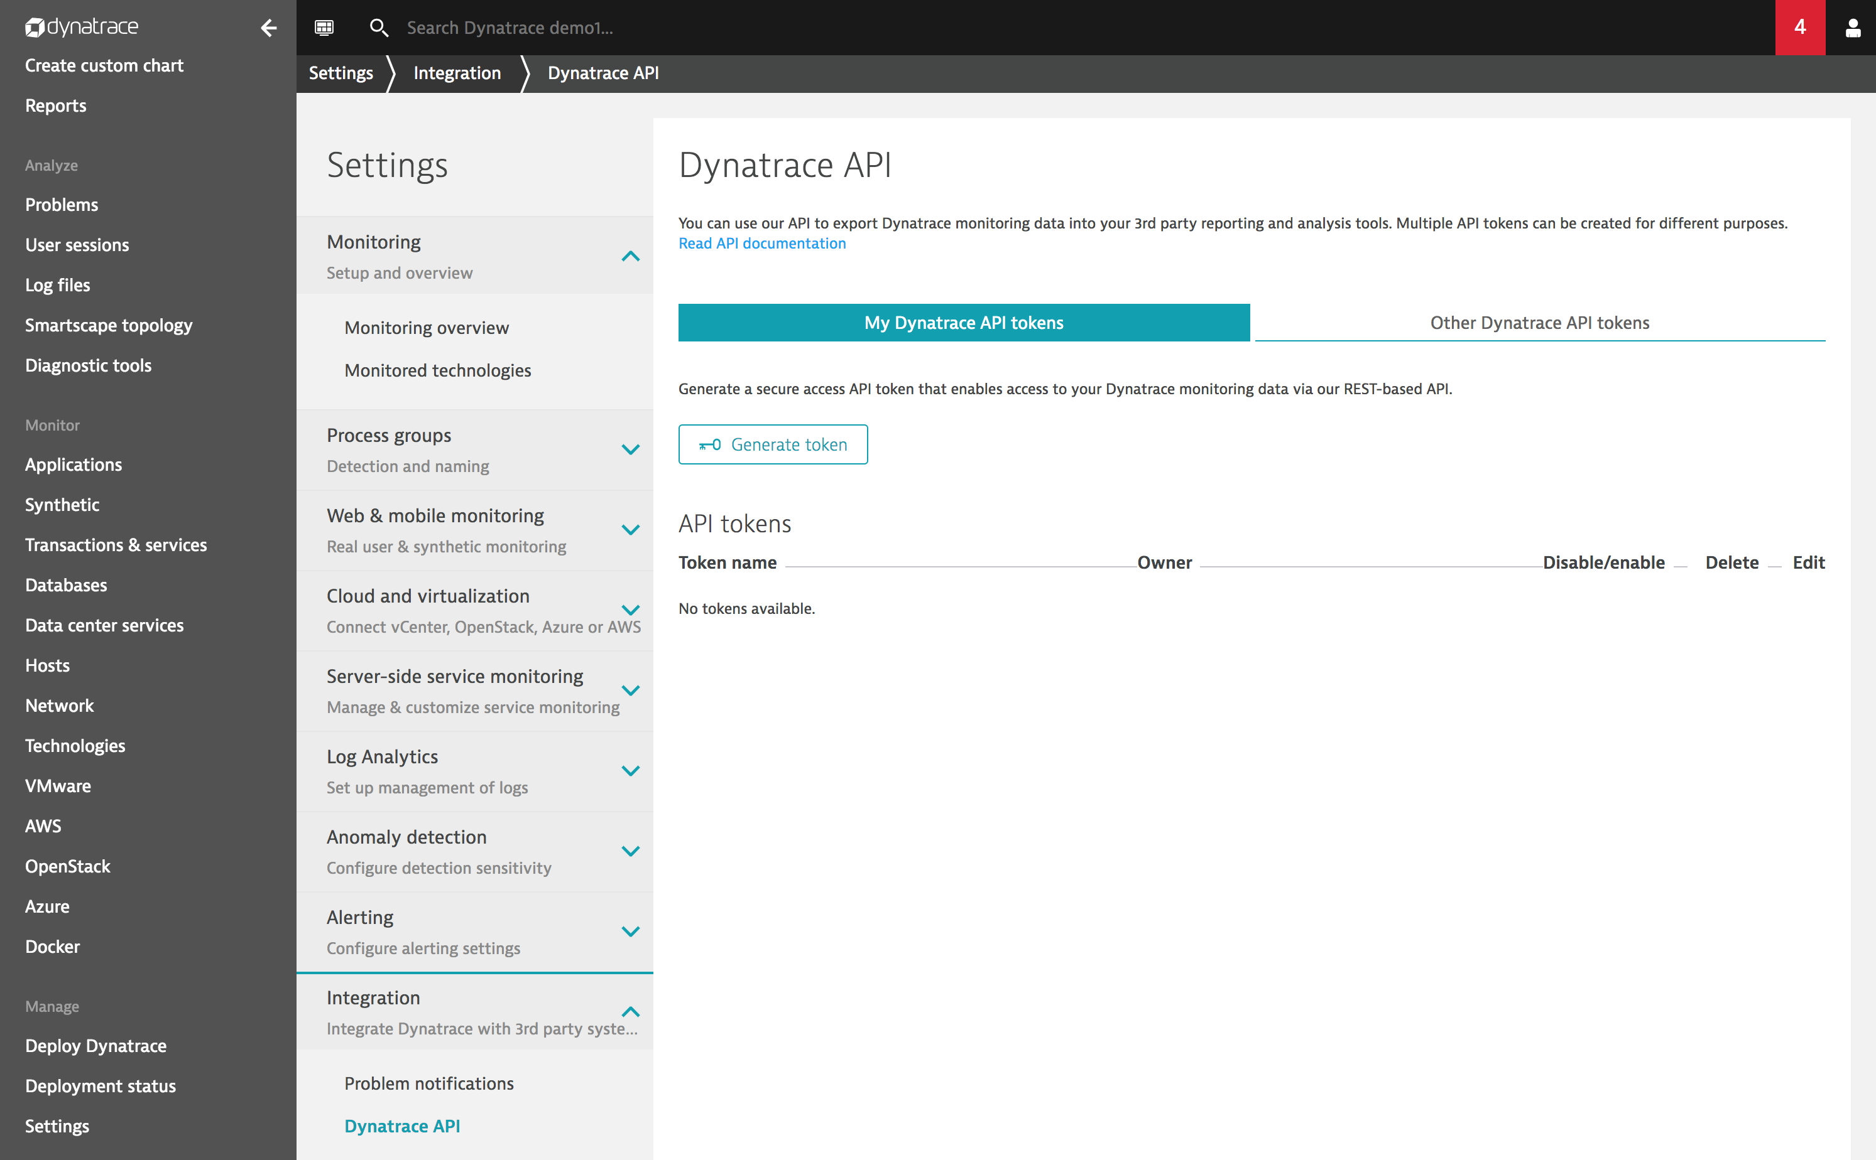
Create an API Token
A token is needed to access the Dynatrace API. DevOps Permissions are needed to create a token.
Open Dynatrace Demo
Settings / Integration / Dynatrace API
Toggle all switches to ‘On’
Name the Token ‘<yourname> API Token’
Click ‘Generate’

Slide 7
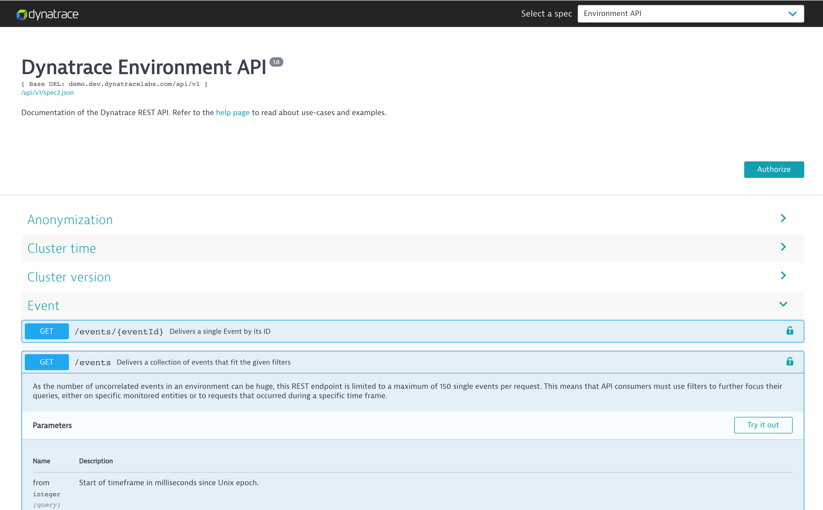
Explore the REST API
The REST API documentation lets you browse and test all available endpoints
Copy the API token
On the Dynatrace API screen, click ‘Dynatrace API Explorer’
Click ‘Authorize’
Paste the token into each ‘value’ field and click ‘Authorize’
Try out ‘GET /problem/status’

Slide 8
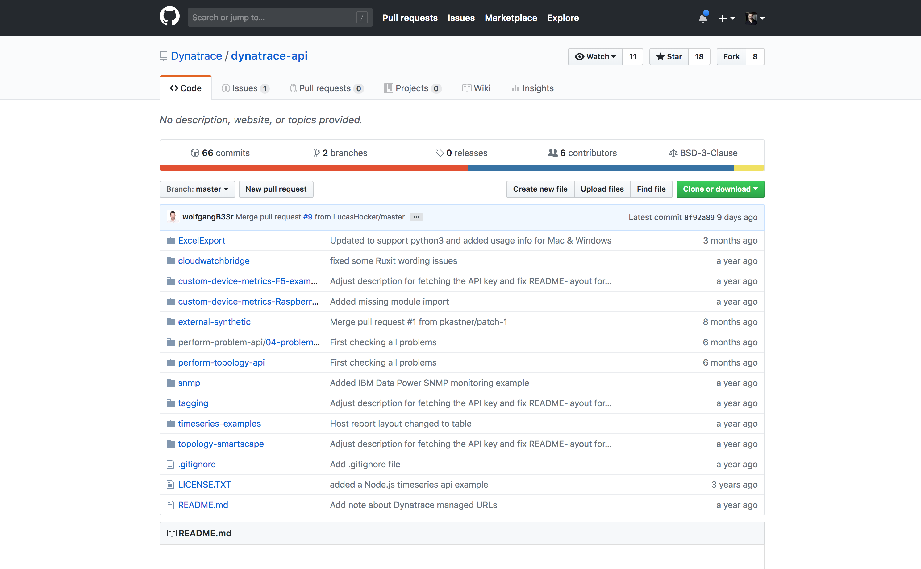
Examples: 1. Service Map Visualization
git clone https://github.com/Dynatrace/dynatrace-api
Open in Visual Studio Code
Go to perform-problem-api
Open HTML file add, add credentials
Open in Browser

Slide 9
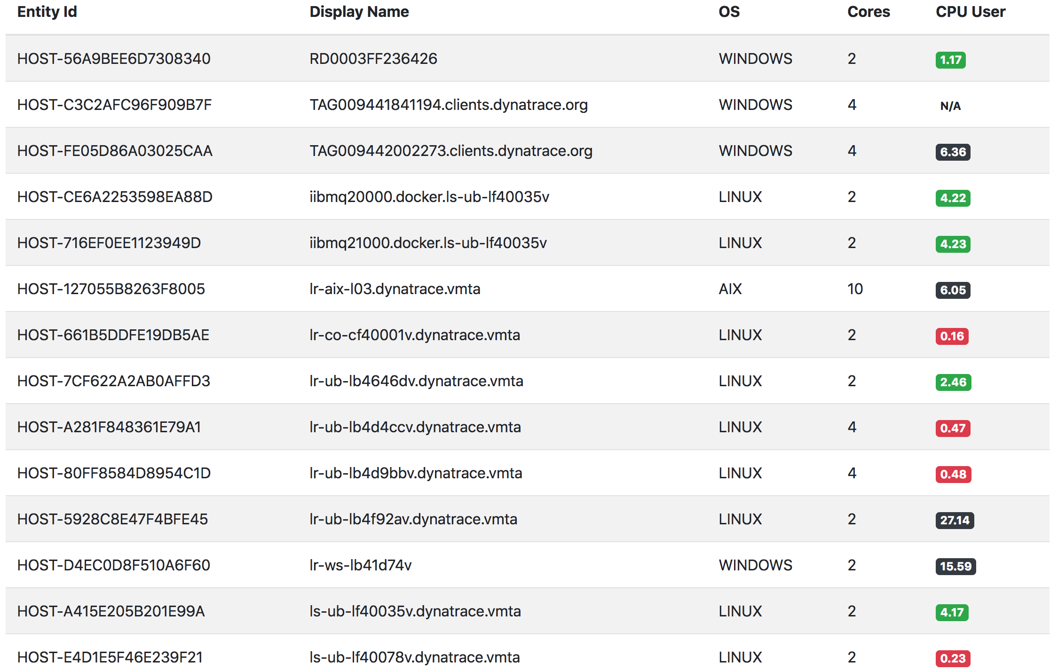
Examples: 2. Node.js: Low Utilized Hosts
git clone https://github.com/danielkhan/sample-dynatrace-api.git
Open in Visual Studio Code
Copy env-sample to .env
Set credentials
npm start
Go to http://localhost:3000

